Slide 1
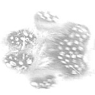
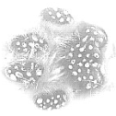
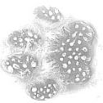
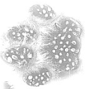
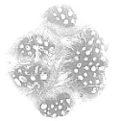
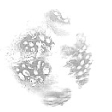
1. In the experiment, a glass plate is used as the substrate. After spraying speckle on the paw pads, the cats move straight ahead on the substrate, a high speed camera installed under the substrate captures the moving images, and the images are captured at 200 frames per second. Fig.A-Fig.H are the partial images of the whole contact process.
A
B
C
D
Upcoming contact t=0.000s t=0.015s t=0.025s
E
F
G
H
t=0.185s t=0.255s t=0.275s t=0.290s
one complete contact process at 0.78m/s（T_{total}=0.305s）

